Slide 1

The 2018 SUPPORT Act and its Effect on Female U.S. Veteran Opioid Usage
The 1st Percentile Team
Rocco Costanzo, Kyle Liang, Casey Ng, Jonathan Shan, and Eric Tran

Slide 2
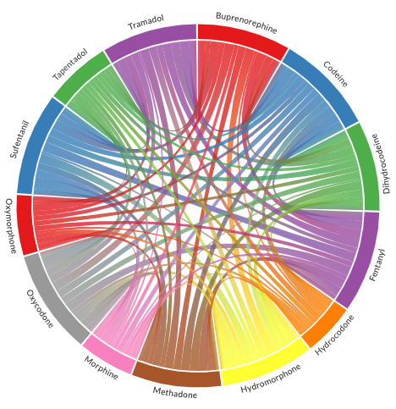
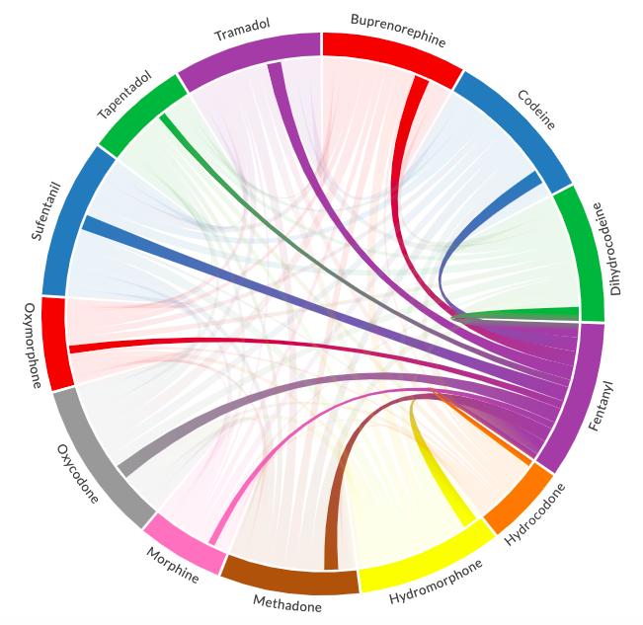
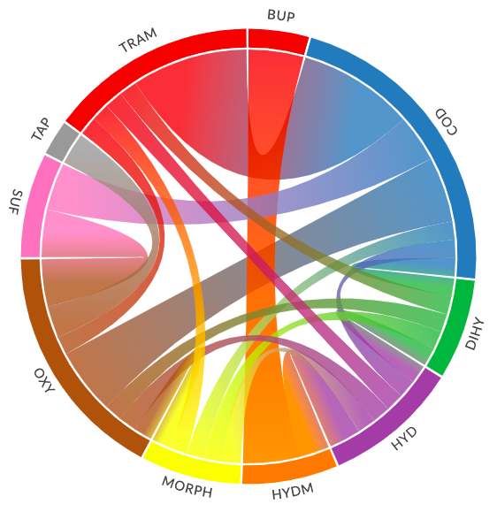
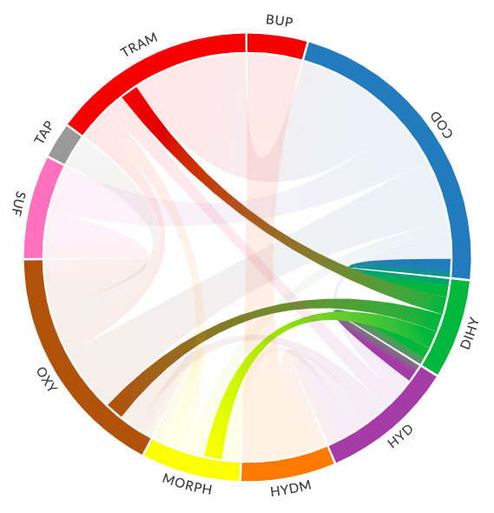
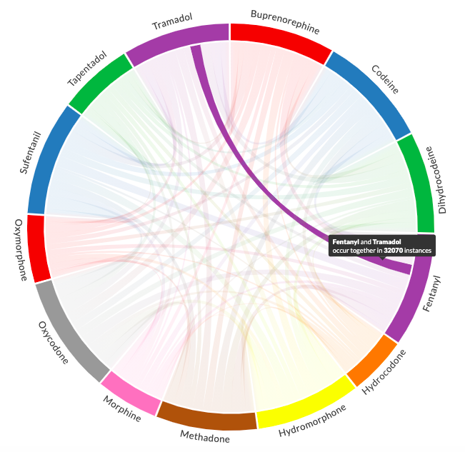
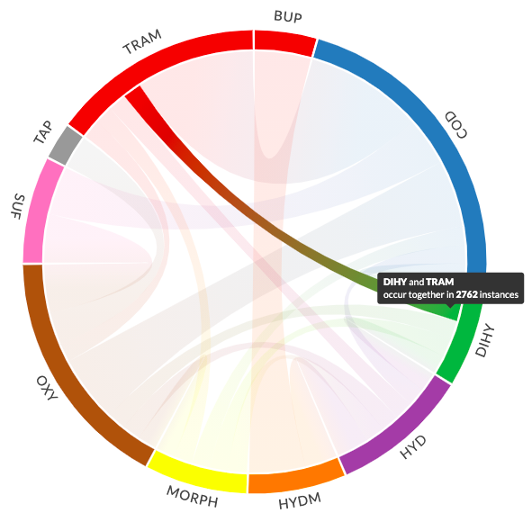
Visualizing Misuse of 2-Drug Combos
in 2018 and 2019
2018
2019
Figure: Chord Diagrams of 2-Drug Misuse Combos with Further Breakdown by Drug Type

Slide 3
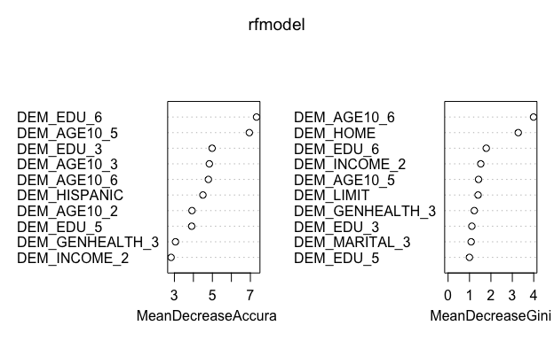
Modeling Drug Misuse in 2019
Random Forest Model Fit on 2019 Female Veteran Data
Predictor Variables: Only demographic data (Age, Race, Income, Marital Status, Education Level, General Health Status, # People in the Household
Response Variable: Opioid Misuse in the Last 90 Days
After a train-test split of the original unweighted data, we fit a model with adjusted class weights to account for response variable class imbalance.
Even with some strange model metrics (perfect precision, recall, and F1) likely due to small sample sizes and huge class imbalances, we believe the model variable importance rankings have a lot of value.
Figure: Variable Importance Plot for the Random Forest Model
External Data and Bibliography:
National Institute on Drug Abuse: drugabuse.gov/drug-topics/military-life-substance-use and drugabuse.gov/publications/drugfacts/substance-use-military-life#ref
John Hudak, Brookings Institution: Assessing and improving the government’s response to the veterans’ opioid crisis
CDC: cdc.gov/drugoverdose/epidemic/index.html
Kaiser Family Foundation: kff.org/medicaid/issue-brief/federal-legislation-to-address-the-opioid-crisis-medicaid-provisions-in-the-support-act/

